Slide 1
EyeWatchOne
Hyperlocal incident prediction for cities and emergency services

Slide 2
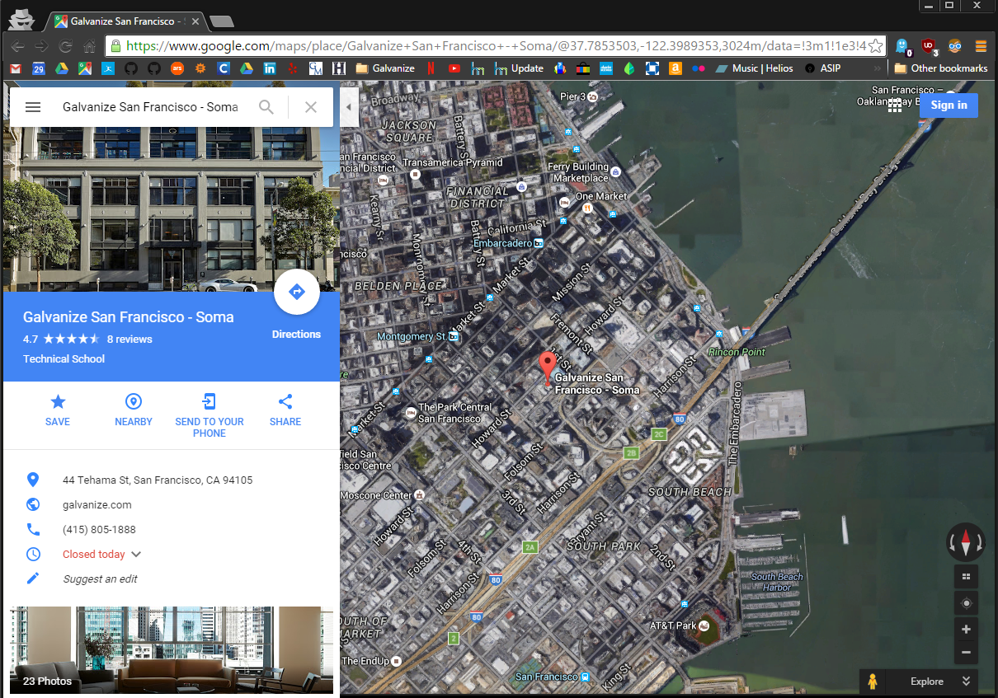
You may be familiar with Google Maps

Slide 3
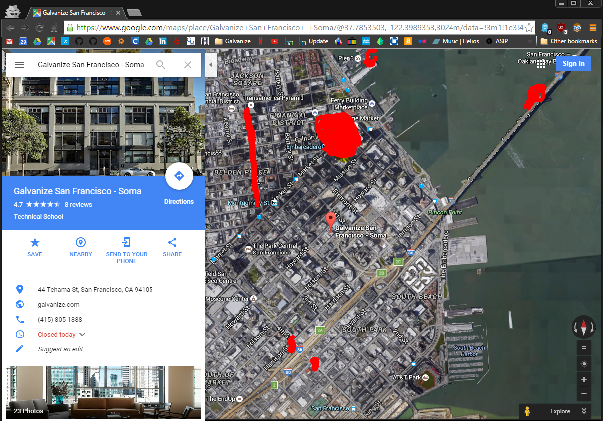
What if that map told you where accidents would happen?

Slide 4
EyeWatchOne accomplishes this through data
Historical weather data from National Climate Data Center (NCDC)
Historical insurance data from Allstate
Live, streaming weather from Weather Underground
Satellite images from NASA NEX Landsat

Slide 5
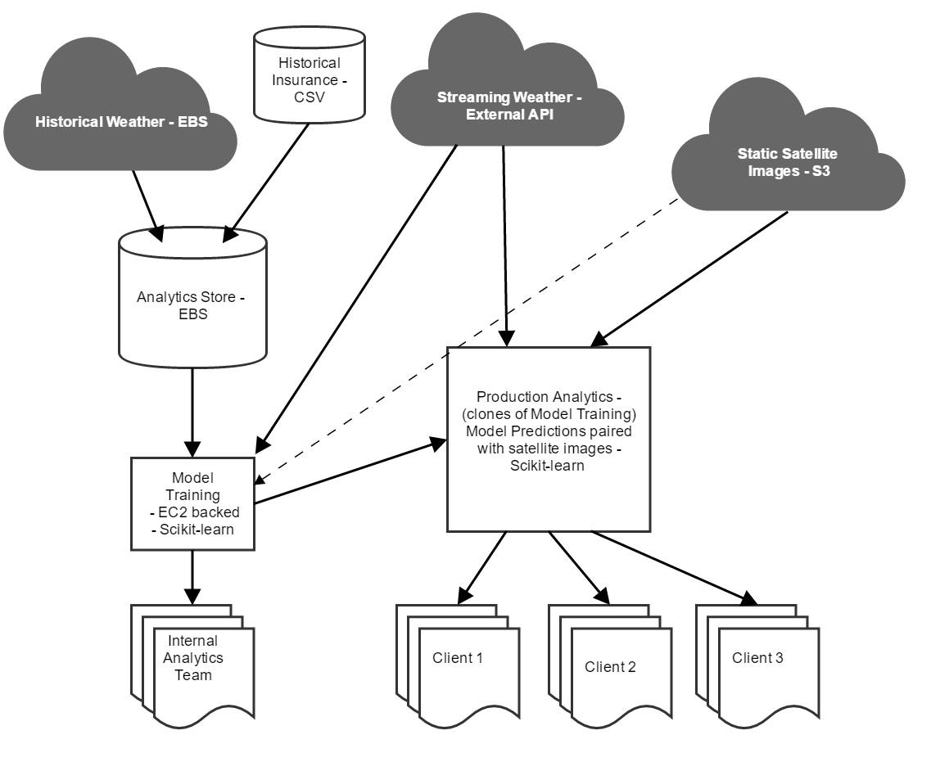
What does all this look like?

Slide 6
What does all this look like?
V 1.0

Slide 7
Time for some code

Slide 8
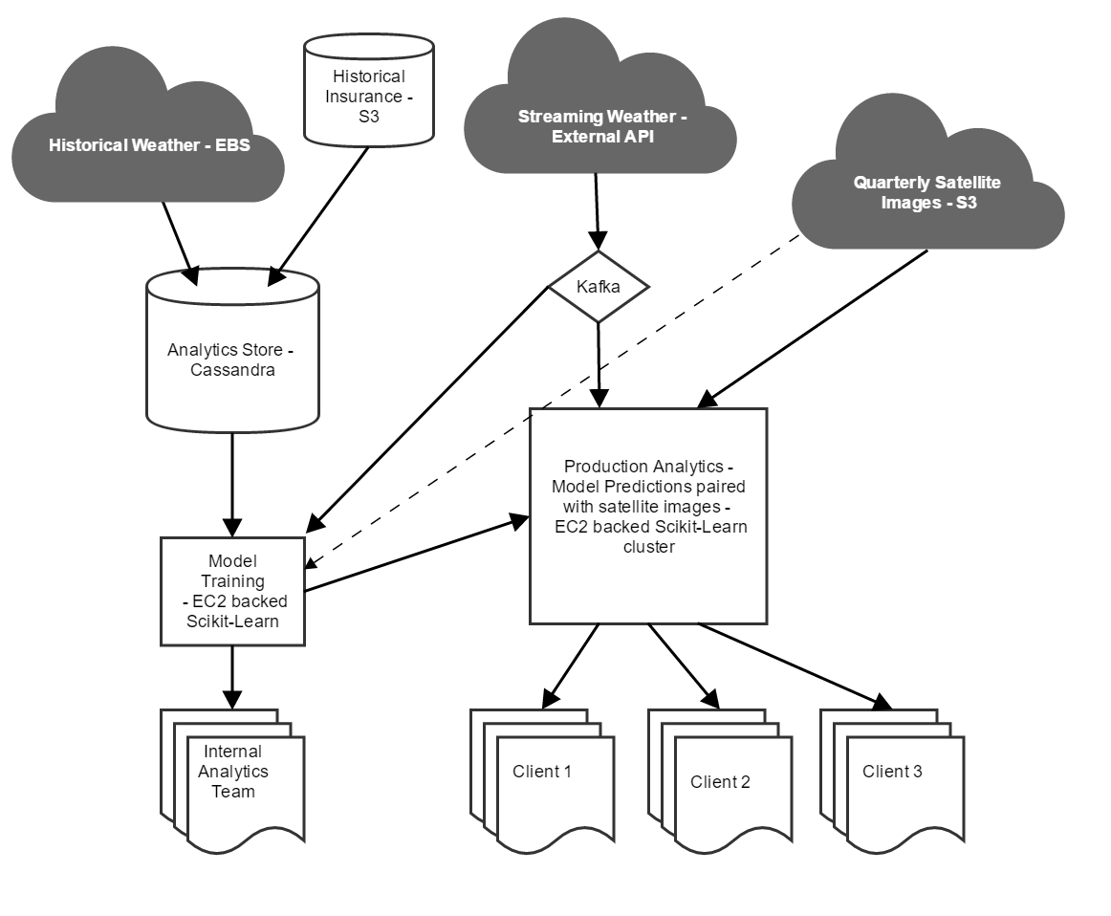
Future Growth
V 2.0

Slide 9
Prototype Costs

Slide 10

Prototype Costs

Slide 11
Thank You

